Slide 1
Activation Energy and Catalyst

Slide 2
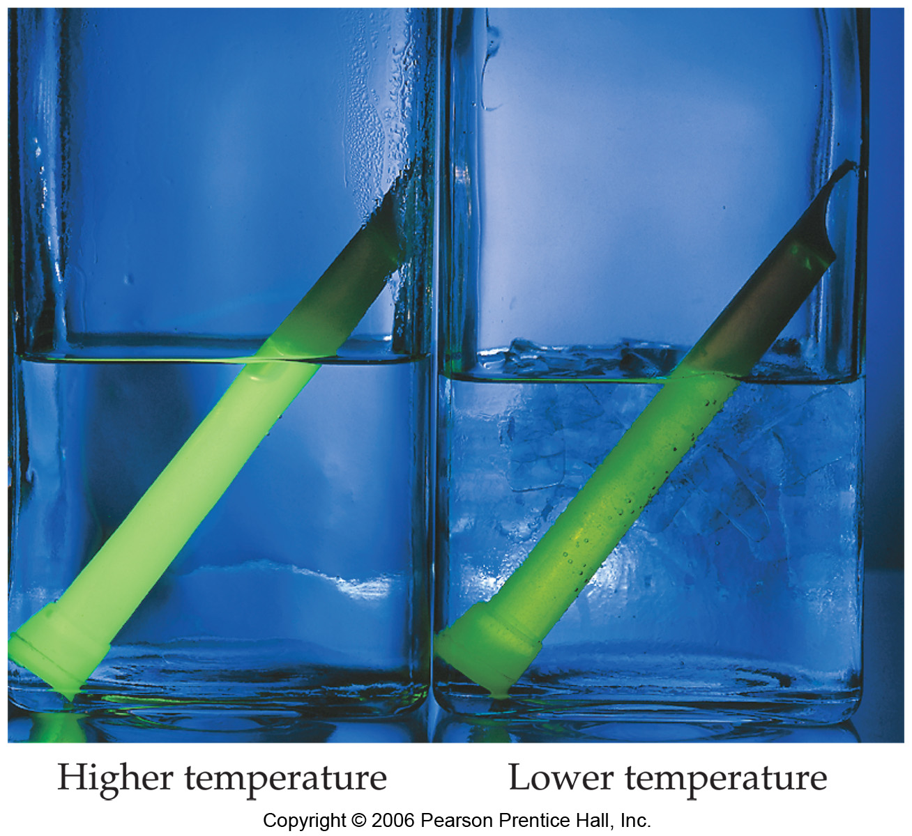
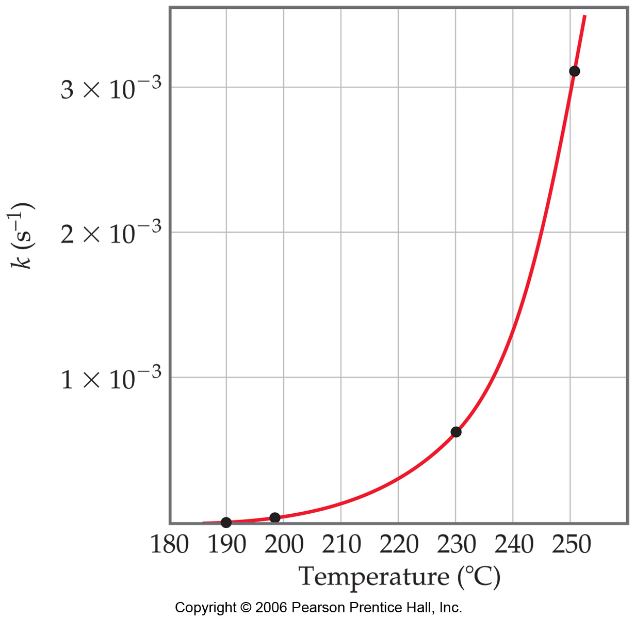
Temperature and Rate
Generally, as temperature increases, so does the reaction rate.
This is because k is temperature dependent.

Slide 3
The Collision Model
In a chemical reaction, bonds are broken and new bonds are formed.
Molecules can only react if they collide with each other.

Slide 4
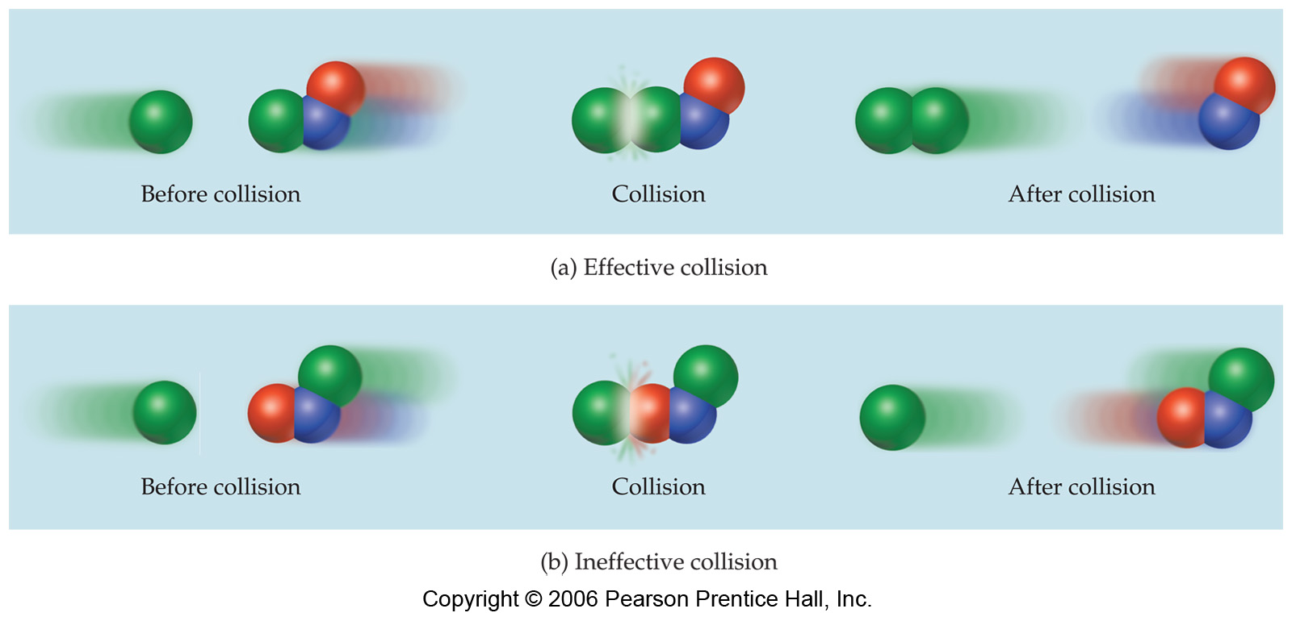
The Collision Model
Furthermore, molecules must collide with the correct orientation and with enough energy to cause bond breakage and formation.

Slide 5
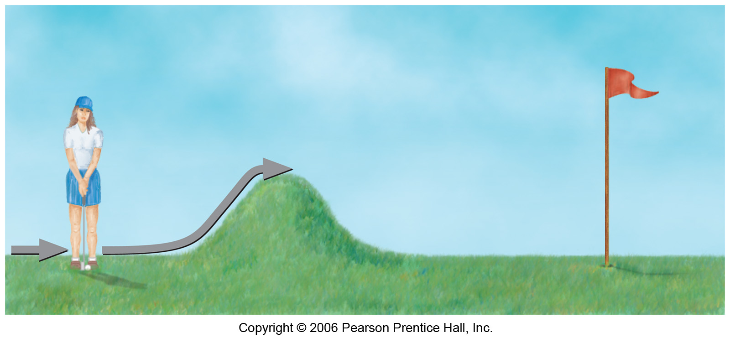
Activation Energy
In other words, there is a minimum amount of energy required for reaction: the activation energy, E_{a}.
Just as a ball cannot get over a hill if it does not roll up the hill with enough energy, a reaction cannot occur unless the molecules possess sufficient energy to get over the activation energy barrier.

Slide 6
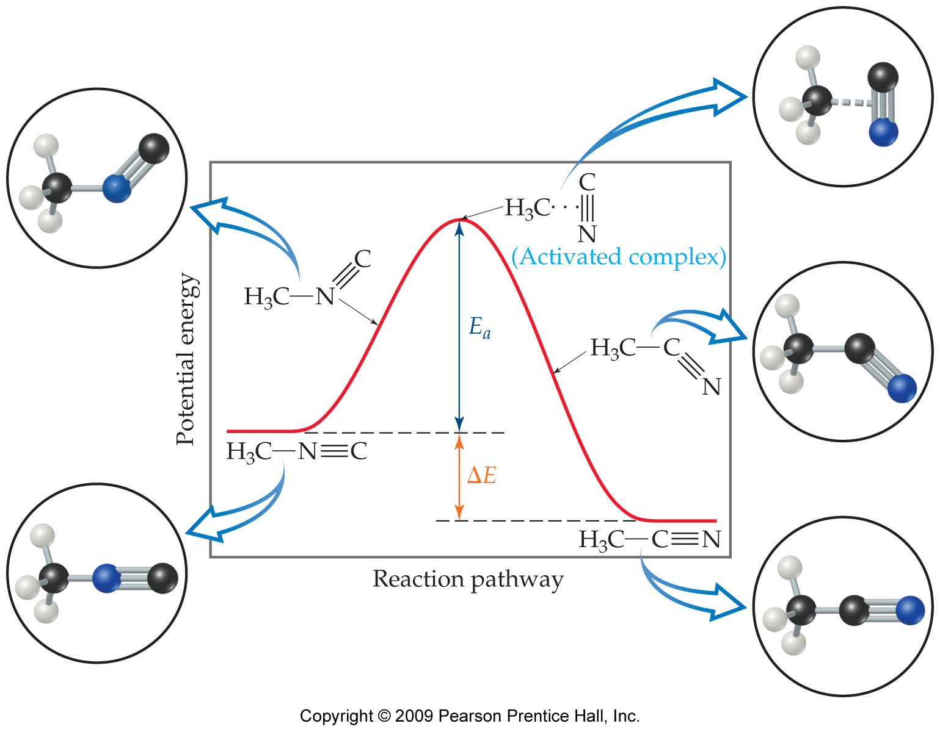
Reaction Coordinate Diagrams
It is helpful to visualize energy changes throughout a process on a reaction coordinate diagram like this one for the rearrangement of methyl isonitrile.

Slide 7
Reaction Coordinate Diagrams
The diagram shows the energy of the reactants and products (and, therefore, ΔE).
The high point on the diagram is the transition state.
The species present at the transition state is called the activated complex.
The energy gap between the reactants and the activated complex is the activation energy barrier.

Slide 8
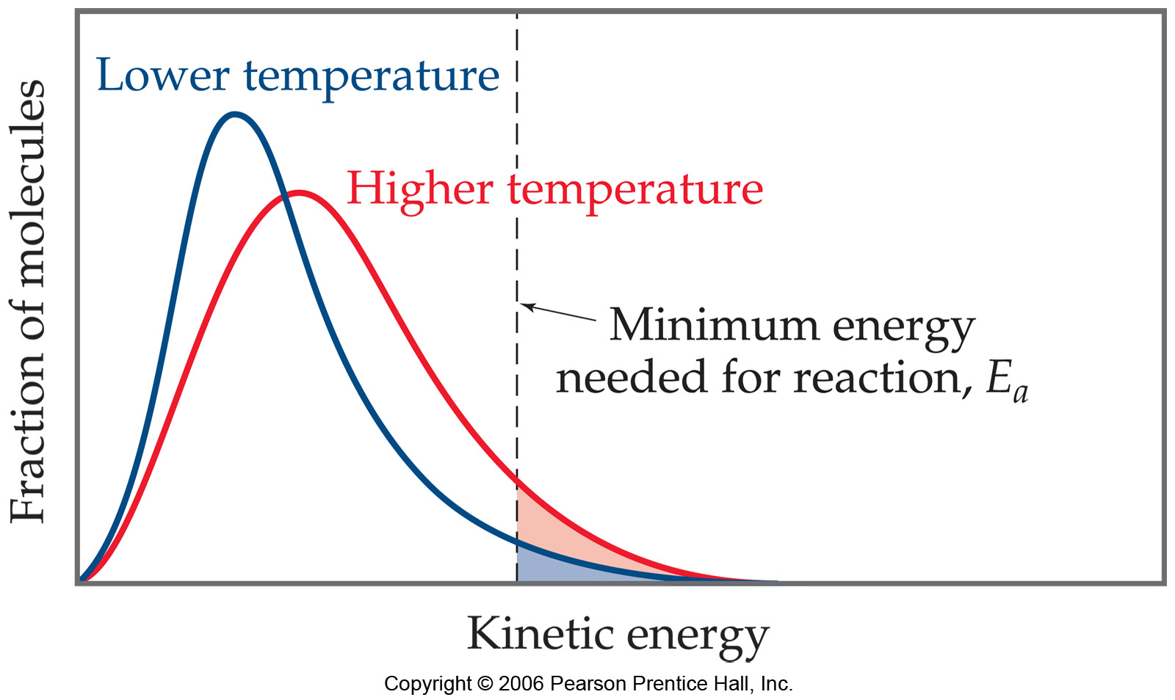
Maxwell–Boltzmann Distributions
Temperature is defined as a measure of the average kinetic energy of the molecules in a sample.
At any temperature there is a wide distribution of kinetic energies.

Slide 9
Maxwell–Boltzmann Distributions
As the temperature increases, the curve flattens and broadens.
Thus at higher temperatures, a larger population of molecules has higher energy.

Slide 10
Maxwell–Boltzmann Distributions
If the dotted line represents the activation energy, then as the temperature increases, so does the fraction of molecules that can overcome the activation energy barrier.
As a result, the reaction rate increases.

Slide 11
Maxwell–Boltzmann Distributions
This fraction of molecules can be found through the expression
where R is the gas constant and T is the Kelvin temperature.
-E_{a}
RT
f = e

Slide 12
Arrhenius Equation
Svante Arrhenius developed a mathematical relationship between k and E_{a}:
k = A e
where A is the frequency factor, a number that represents the likelihood that collisions would occur with the proper orientation for reaction.
-E_{a}
RT

Slide 13
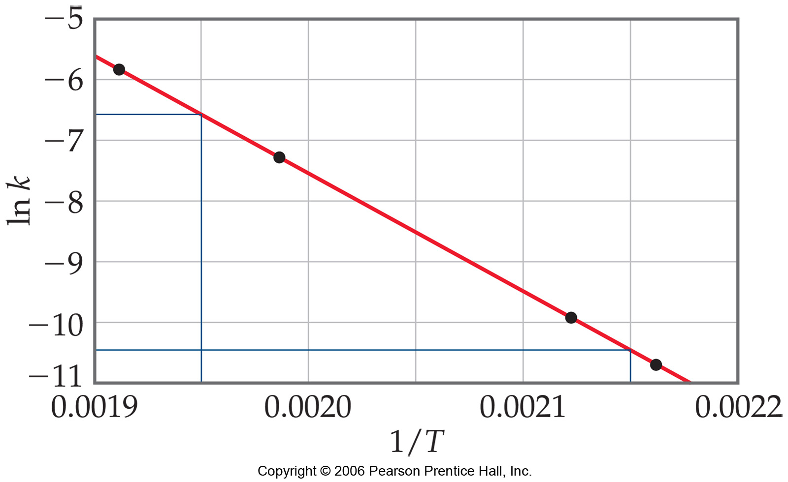
Arrhenius Equation
Taking the natural logarithm of both sides, the equation becomes
ln k = - ( ) + ln A
E_{a}
R
1
T
y = m x + b
Therefore, if k is determined experimentally at several temperatures, E_{a} can be calculated from the slope of a plot of ln k vs. .
1
T

Slide 14
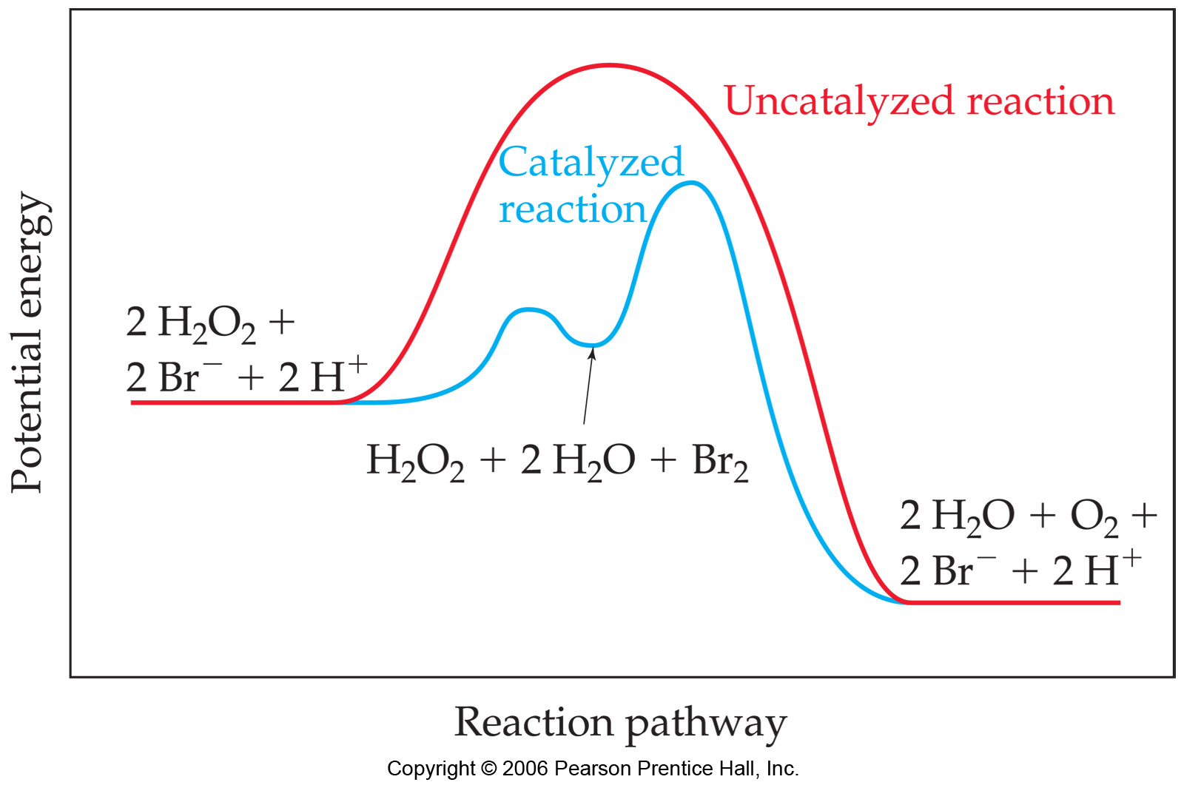
Catalysts
Catalysts increase the rate of a reaction by decreasing the activation energy of the reaction.
Catalysts change the mechanism by which the process occurs.

Slide 15
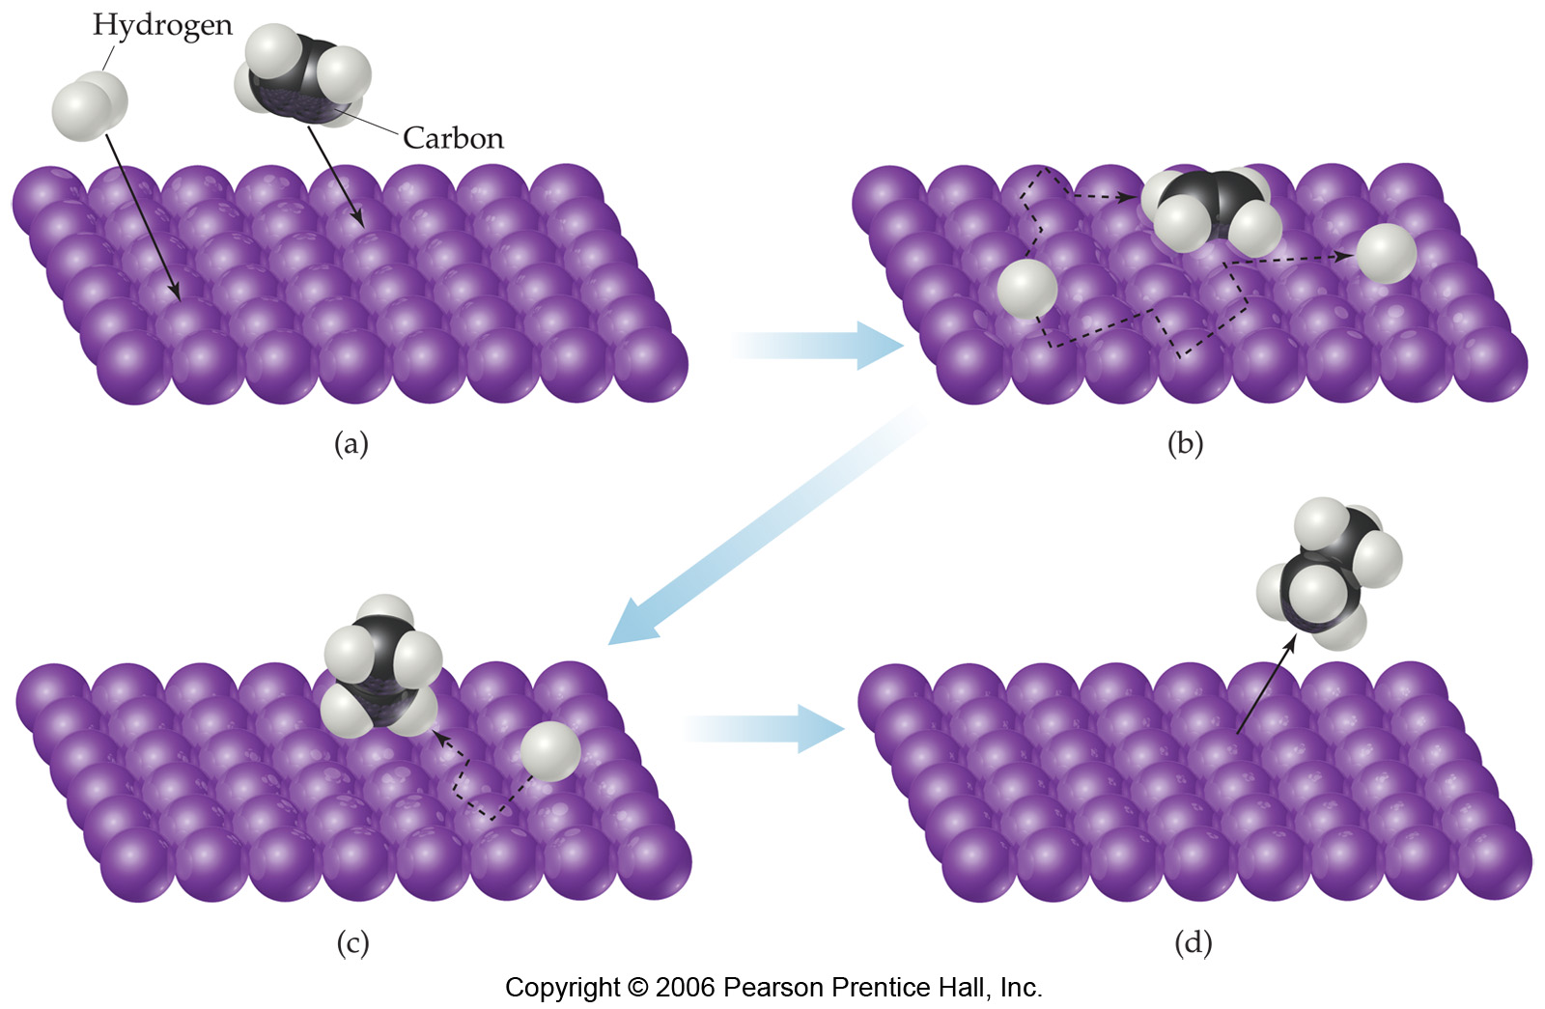
Catalysts
One way a catalyst can speed up a reaction is by holding the reactants together and helping bonds to break.

Slide 16
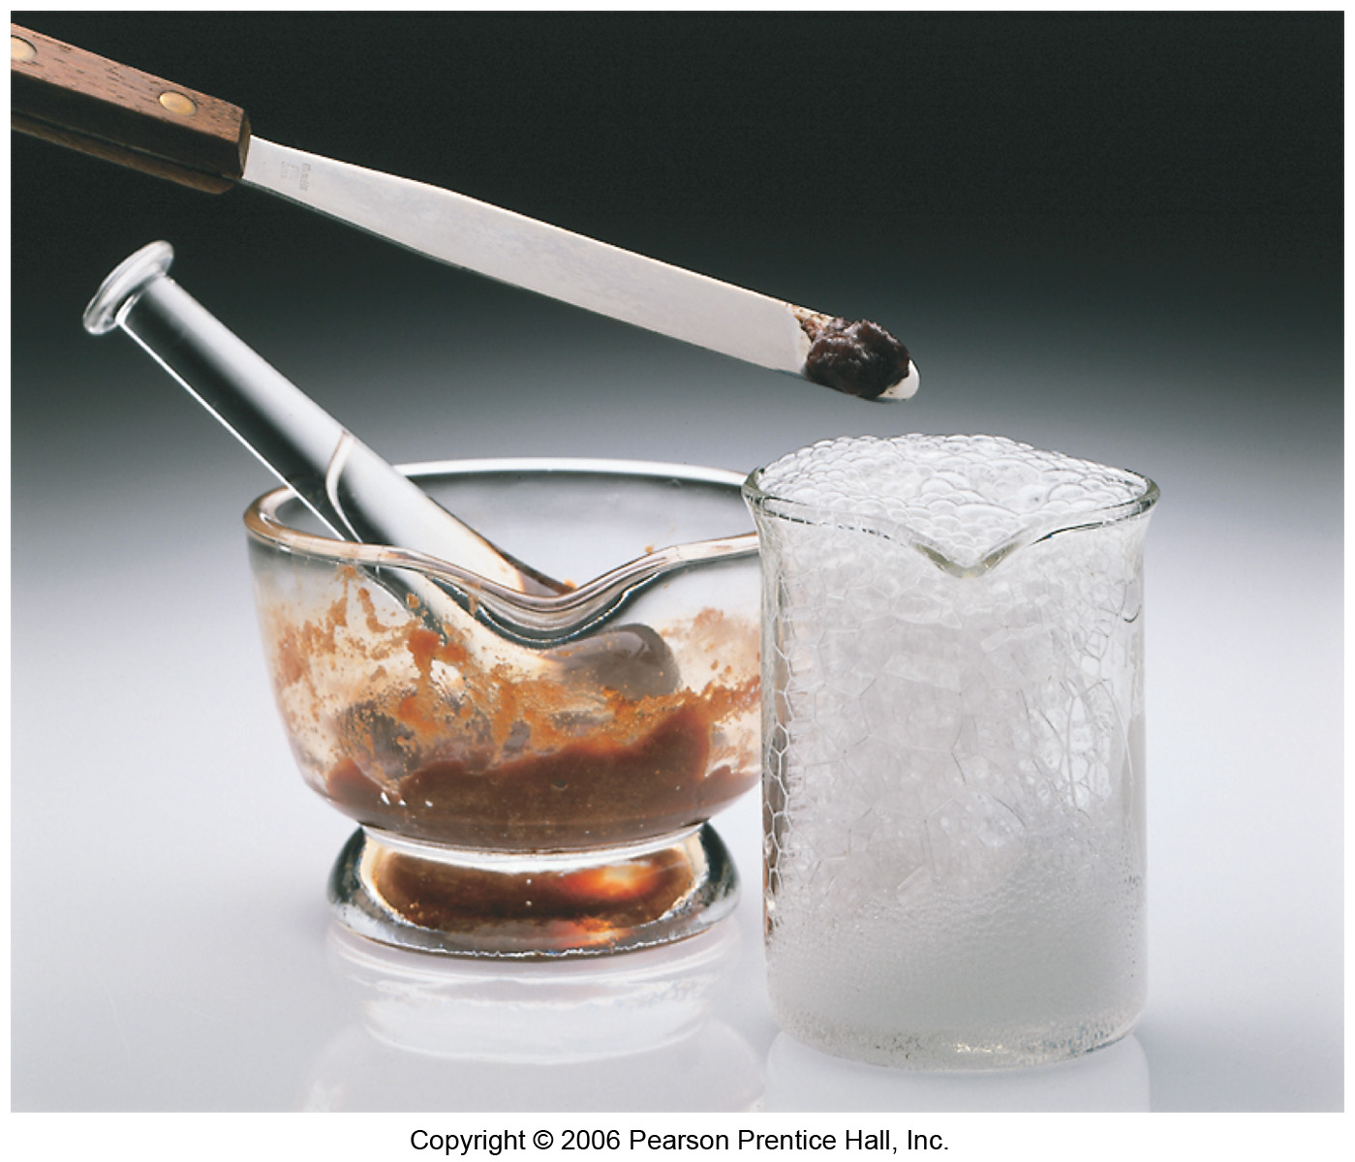
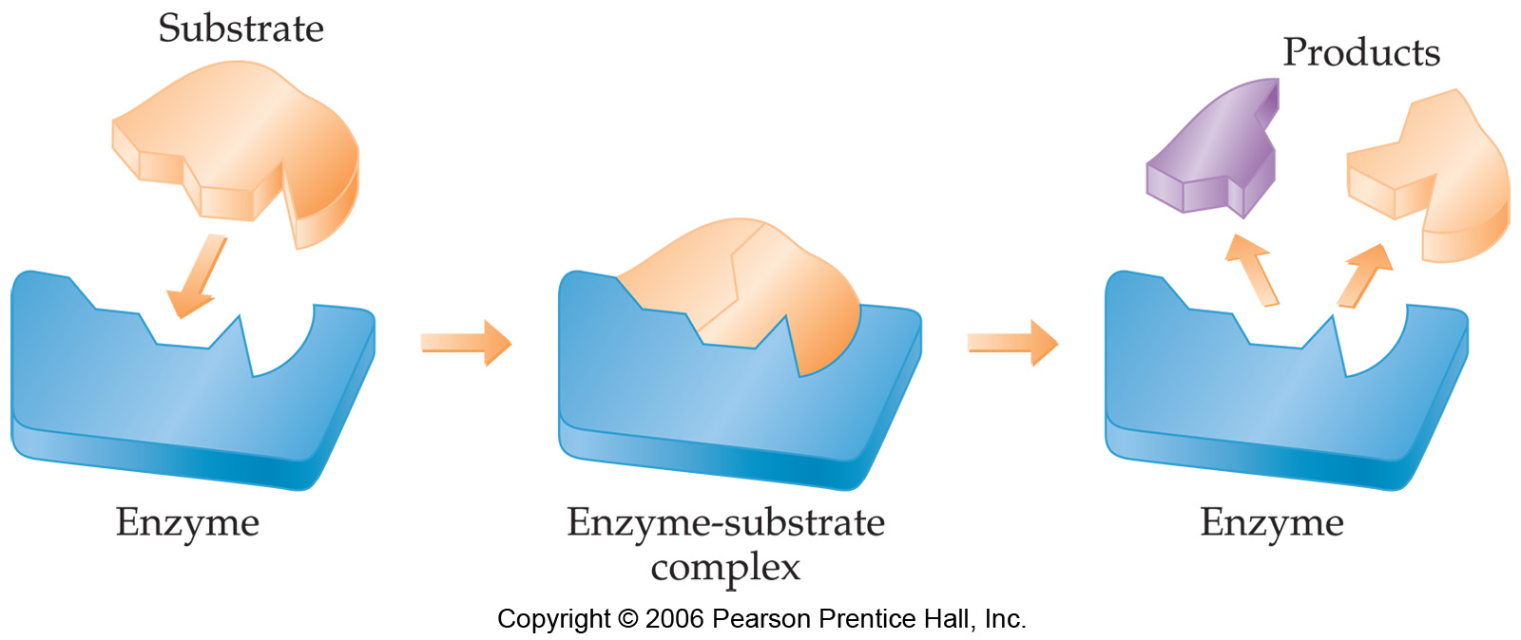
Enzymes
Enzymes are catalysts in biological systems.
The substrate fits into the active site of the enzyme much like a key fits into a lock.

